Slide 1

MilOps Stakeholder Engagement
Wednesday, February 14 , 2024

Slide 2

Agenda
Time | Topic | Presenter
1000 – 1005 | Opening Remarks | Mr. Nick Ballard
1005 – 1010 | MILOPS Update | Mr. Nick Ballard
1010- 1020 | NTAC Update | Mr. Nick Ballard
1020-1030 | NBAC Update | Mr. Steve Sullivan
1020 – 1030 | NMO TSC Update | Mr. Steve Sullivan
1030-1040 | Open Discussion / Closing Remarks

Slide 3
Milops update
MilOps Community meetings quarterly
MilOps Change Request (CR) Process Document Published – (used to be known as the CCB process)
NIEM 6.0 published – Dec ‘23

Slide 4
MILOPS UPDATE
EMS sharing requests from non-DoD stakeholders
OPR: DISA Defense Spectrum Organization (DSO)
U.S. Message Text Format (MIL-STD-6040) adoption of NIEM
OPR: DISA
STITCHES Translation
OPR: Air Force, Lockheed Martin
MOMS 6.0
NATO Core Data Framework (NCDF)
Notes:
EMS – electromagnetic spectrum
STITCHES – SoS Technology Integration Tool Chain for Heterogeneous Electronic Systems. It is used for rapidly integrating new and legacy mission systems into robust new architectures with improved combat effectiveness. STITCHES is used to enable new data sharing arrangements by resolving differences among systems having different data for the same information – without requiring programmers to create and maintain pairwise translation software.
BI/CV – Background Investigations/Continuous Vetting
ICAM – Identity, Credential, and Access Management
MOMS – MilOps Mission Specific

Slide 5
LEGEND
Data
Service
Translator
Function
Data Store
ADDER
MFE
Diamond Shield COP
JREAP
Observations
Fused Tracks
Stitches
Red Observations
Translates UCI 2.0 to NIEM
NIEM COP
Translates TDM to UCI 2.0/ JREAP
NIEM
Data Fabric
Fused Tracks TDM
Stitches
UCI 2.0 COP
UCI 2.0
Blue Self reports
Blue Self report TDM
NIEM
Perceived Ground Truth
TDM REPO
NIEM REPO
JWX
Implemented

Slide 6
Ntac update
NTAC has identified a few minor issues in NIEM Model Version 6.0 PS01
Plan to submit a PS02 to the PGB for approval soon
NTAC re-elected Jim Cabral as the liaison to the PGB

Slide 7
NBAC TSC Update
Update NIEM MODEL Version 6.0 PSO1 TO PS02 correcting Issue #96
Submit PS02 for approval
Obtain 3 Statements-of-Use for NIEM Model 6.0
Advance NIEM Model Version 6.0 PS02 to OS
NBAC TSC Continues to Encourage Sub-Committee Submission of CLAs and Governance Documents
Continue to engage the Department of National Defence (DND) (Canada) to encourage DND adoption of the NIEM Model and consider NIEMOpen Sponsorship
Support NIEMOpen 2025 Symposium efforts

Slide 8
NIEM MODEL Version 6.0 PS01 “what’s new”
Updates to support upcoming [NIEM-NDR-v6.0] changes, including:
Adapter changes - New representation terms and a simpler type syntax
Attribute augmentations - semantically-named attribute
Attribute wildcards - Allows declared attributes to be added to any NIEM element property
Metadata changes - Now treated like regular objects
Role changes - Leverages standard type extension and the existing `structures:uri`
Updates related to new digital identity requirements led by the Emergency Management domain
Code set updates, including:
Updates provided by the FBI for the National Crime Information Center (NCIC) codes
GENC codes, version 3-12
PS02 correction needed to redress Issue #96
SimpleObjectAttributeGroup, AdapterType, AugmentationType, and ObjectType requires correction:
Update schemas to reflect PS02
<xs:attribute ref="structures:appliesToParent"/>
<xs:attribute ref="structures:id" />
<xs:attribute ref="structures:ref" /> <xs:attribute ref="structures:uri" />
<xs:anyAttribute processContents="strict" namespace="##other" />

Slide 9
Nmo TSC Update
Continue planning for a NIEMOpen 2025 Symposium event
Updating NIEM Training to reflect NIEM Model Version 6.0
Bringing MEP Builder Tool online
Supporting NIEM Model Version 6.0 PS02 update
Implementing LMS, EIN Presswire and AWS
NIEM.org updates

Slide 10
Niemopen news
PGB exploring possible NMO transition
Exploring courses-of-action
What does a new organization look like: Co-Leads/Co-Chairs
Responsibilities/activities could be distributed across sponsoring organizations
Costs vs. benefits
Risks
DAMA
Scott Renner & Frank Klucznik drafting NIEM text for next DMBOK
GTRI Contract
Has been completed and now supporting NBAC, NTAC, & PGB
NSF Grant
Training
Received approval from PGB to purchase LearnPress Learning Management System (LMS)
LMS provides mechanism to collect analytics and track training progress
Future Vision – formal NIEMOpen certification on par w/Industry (Microsoft)
PDUs, Certificates acknowledging course completion
Update current curriculum to reflect:
Model Version 6.0
API 2.0
NDR v6.0
MEP & CMF tools

Slide 11
Open Discussion / Closing Remarks

Slide 12

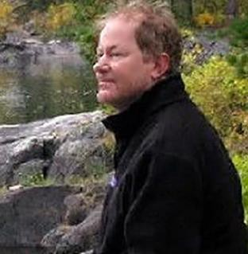
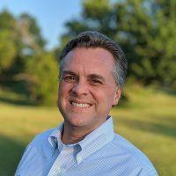
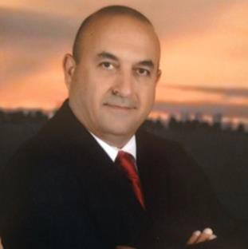
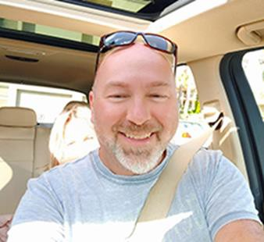

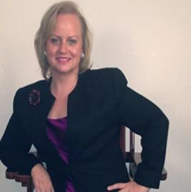
NMO, NBAC, & NTAC TSC CO-CHAIRS
TSC | Approved (TSC CHAIRS)
NMO TSC | Ms. Katherine Escobar & Ms. Beth Smalley
NBAC TSC | Mr. Kamran Atri & Mr. Thomas Krul
NTAC TSC | Dr. Scott Renner & Mr. Jim Cabral
NTAC
TSC
Mailing Lists
NIEMOpen: https://lists.oasis-open-
projects.org/g/niemopen
PGB: https://lists.oasis-open-projects.org/g/niemopen-pgb
NTAC TSC: https://lists.oasis-open- projects.org/g/niemopen-ntactsc
NBAC TSC: https://lists.oasis-open- projects.org/g/niemopen-nbactsc
NMO TSC: https://lists.oasis-open- projects.org/g/niemopen-nmotsc
NBAC TSC
NMO TSC

Slide 13

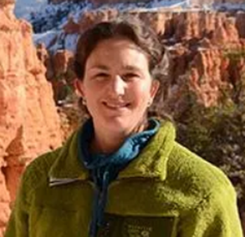

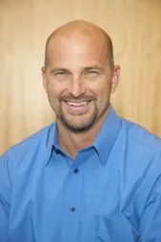
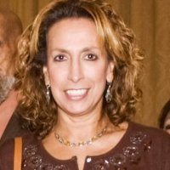
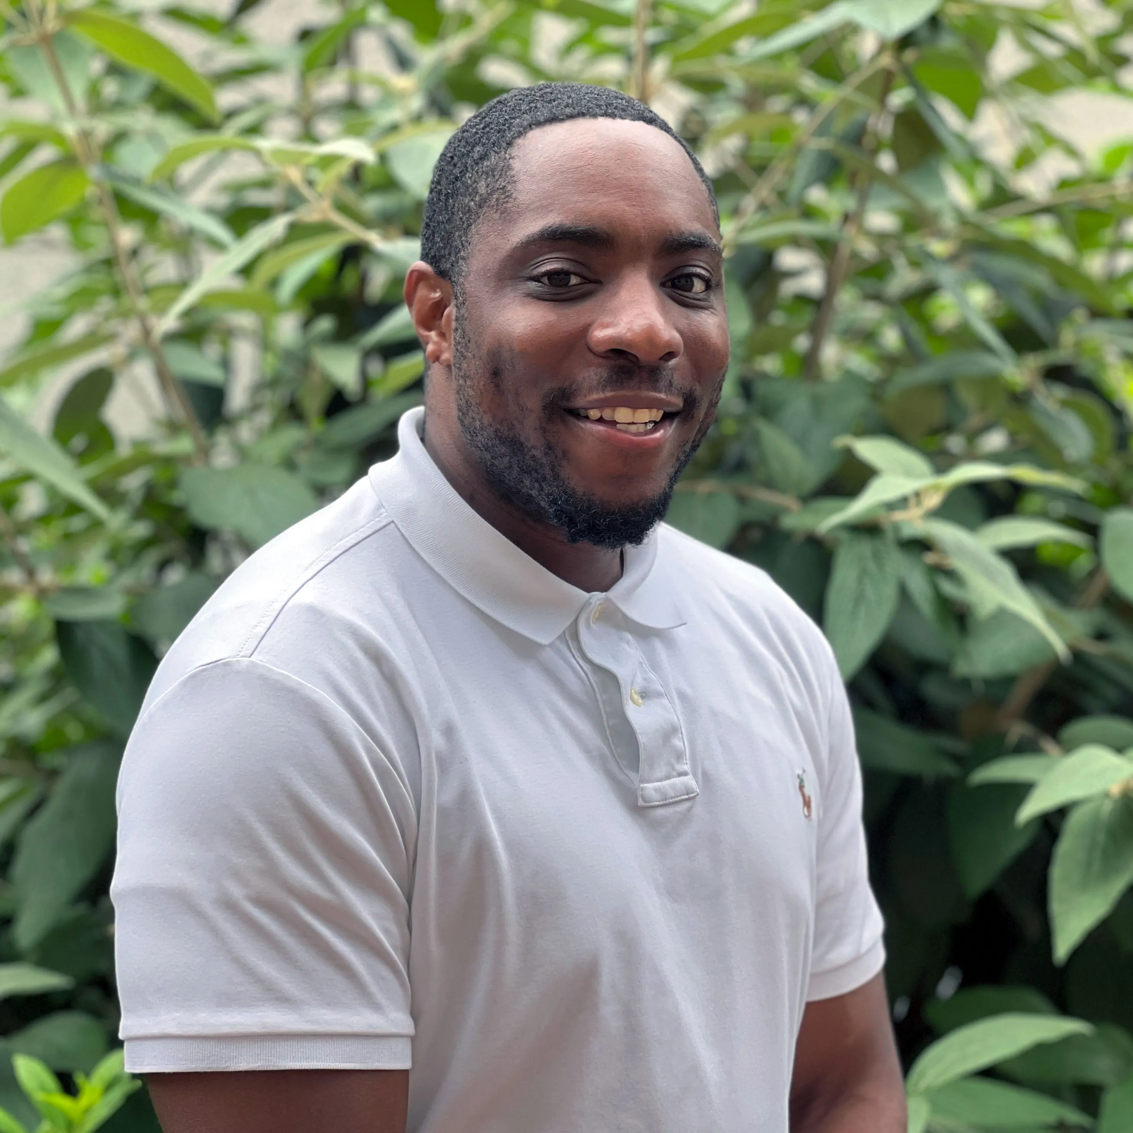
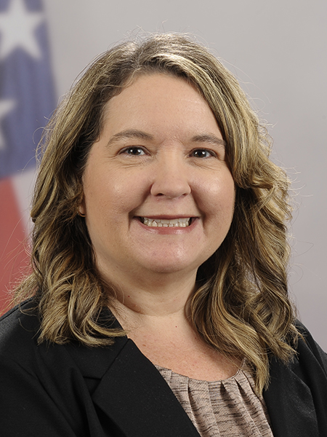







PGB SPONSOR APPOINTED VOTING MEMBERS
Ms. Katherine Escobar
PGB Chair
Deputy Division Chief, Data and Standards Division at Joint Staff J6 and NIEM Managing Director
Ms. Christina Bapst-Stump
Science and Technology Directorate, US Department of Homeland Security
Mr. Gary Egner
Director Business Development, Equivant
Mr. John Wandelt
Principal Research Scientist, Georgia Tech Research Institute
Ms. Maria Cardiellos
Executive Director
Integrated Justice Information Systems Institute
Mr. Payton Lamb
Data Engineer
Commonwealth of Virginia
Office of the secretary of Administration
Office of Data Governance and Analytics
Ms. April Mitchell
FBI It Specialist and Technical Lead of Data Standards in the Criminal Justice Information Services (CJIS) Division
Notes:
Open Project Rules - OASIS Open (oasis-open.org)
5.1 Overall guidance for the Project is provided by its Project Governing Board (or PGB). The PGB is composed of one voting member from each Project Sponsor who elects to appoint a PGB member, and (a) if the PGB has one or more Technical Steering Committees, one voting expert representative from each TSC, elected or appointed by that TSC, or (b) otherwise, the PGB may appoint at least one and no more than two voting expert representatives from its community of contributors. The PGB may create additional non-voting PGB member seats for expert representatives to be elected by the TSC or appointed by the PGB. The PGB membership of all such members of any type is conditioned on satisfaction of the CLA requirement of Section 5.2. Voting status on the PGB may be affected by the provisions of Section 5.7.

Slide 14




resources
OASIS Open - OASIS Open (oasis-open.org)
NIEMOpen Web Presence:
http://NiemOpen.org
https://www.niem.gov/
Git Repos
NIEMOpen: https://github.com/niemopen/oasis-open-project
NTAC TSC (admin): https://github.com/niemopen/ntac-admin
NBAC TSC (admin): https://github.com/niemopen/nbac-admin
NMO TSC TBD: in-progress
NIEMOpen Slack Channel: https://join.slack.com/t/niemopen/shared_invite/zt-1n1brwp2p-bRBR~gklra0f5Btdzami5w
Mailing Lists
NIEMOpen: https://lists.oasis-open-projects.org/g/niemopen
NTAC TSC: https://lists.oasis-open-projects.org/g/niemopen-ntactsc
NBAC TSC: https://lists.oasis-open-projects.org/g/niemopen-nbactsc
NMO TSC: https://lists.oasis-open-projects.org/g/niemopen-nmotsc
SLTT Tiger Team: https://lists.oasis-open-projects.org/g/niemopen-sltt

Slide 15
Contact Us
Sub-Committee Co-Chairs
Beth Smalley (757) 203-7177 (DSN 836) Beth.l.smalley.civ@mail.mil
Lavdjola Farrington (757) 203-8544 (DSN 836) Lavdjola.farrington.civ@mail.mil
Secretariat
Nicholas Ballard
(757) 203-9670 (DSN 836) Nicholas.a.ballard.civ@mail.mil
Website
https://niem.github.io/community/milops/
MilOps Email
Js.dsc.j6.mbx.milops@mail.mil

